Slide 1
ACOUSTIC MONITORING OF ECOSYSTEMS
Leveraging bird vocalizations for ecosystems health
A Research Day Presentation
Emasi Collins
1

Slide 2
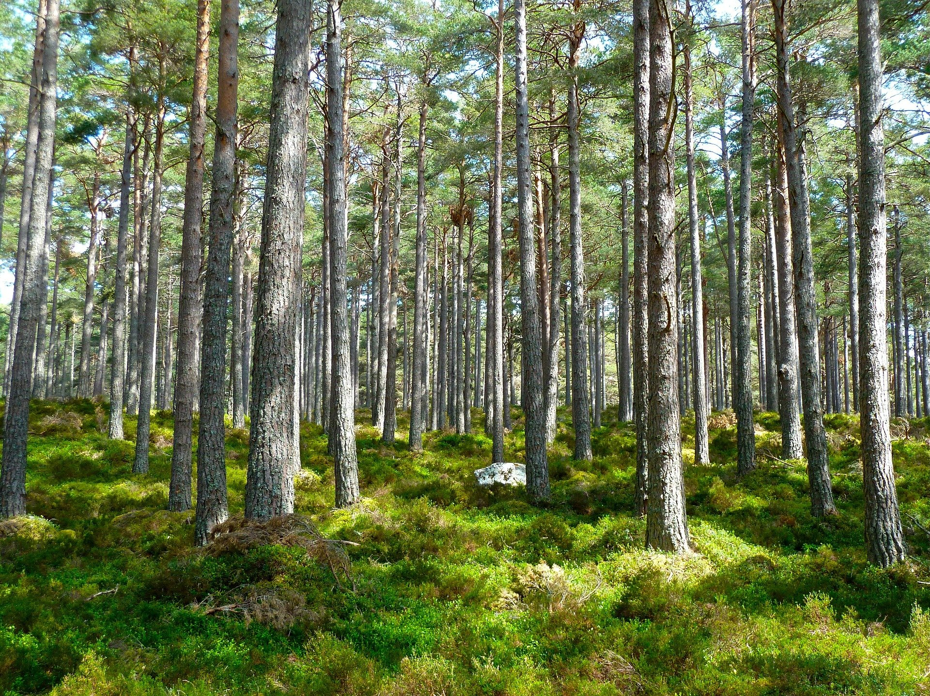
WHY THIS PROJECT?
Ecosystems can be easily stressed by; human activities, climate change, contaminants, and many other variables.
Periodic physical surveys of the ecosystem is disadvantageous.
There is need of an inexpensive and non-invasive tool for ecosystem’s health monitoring.
Notes:
One of the most traditional pervasive method of ecosystem monitoring was periodic physical surveys
Disadvantages
Laborious
Time consuming
Expensive

Slide 3
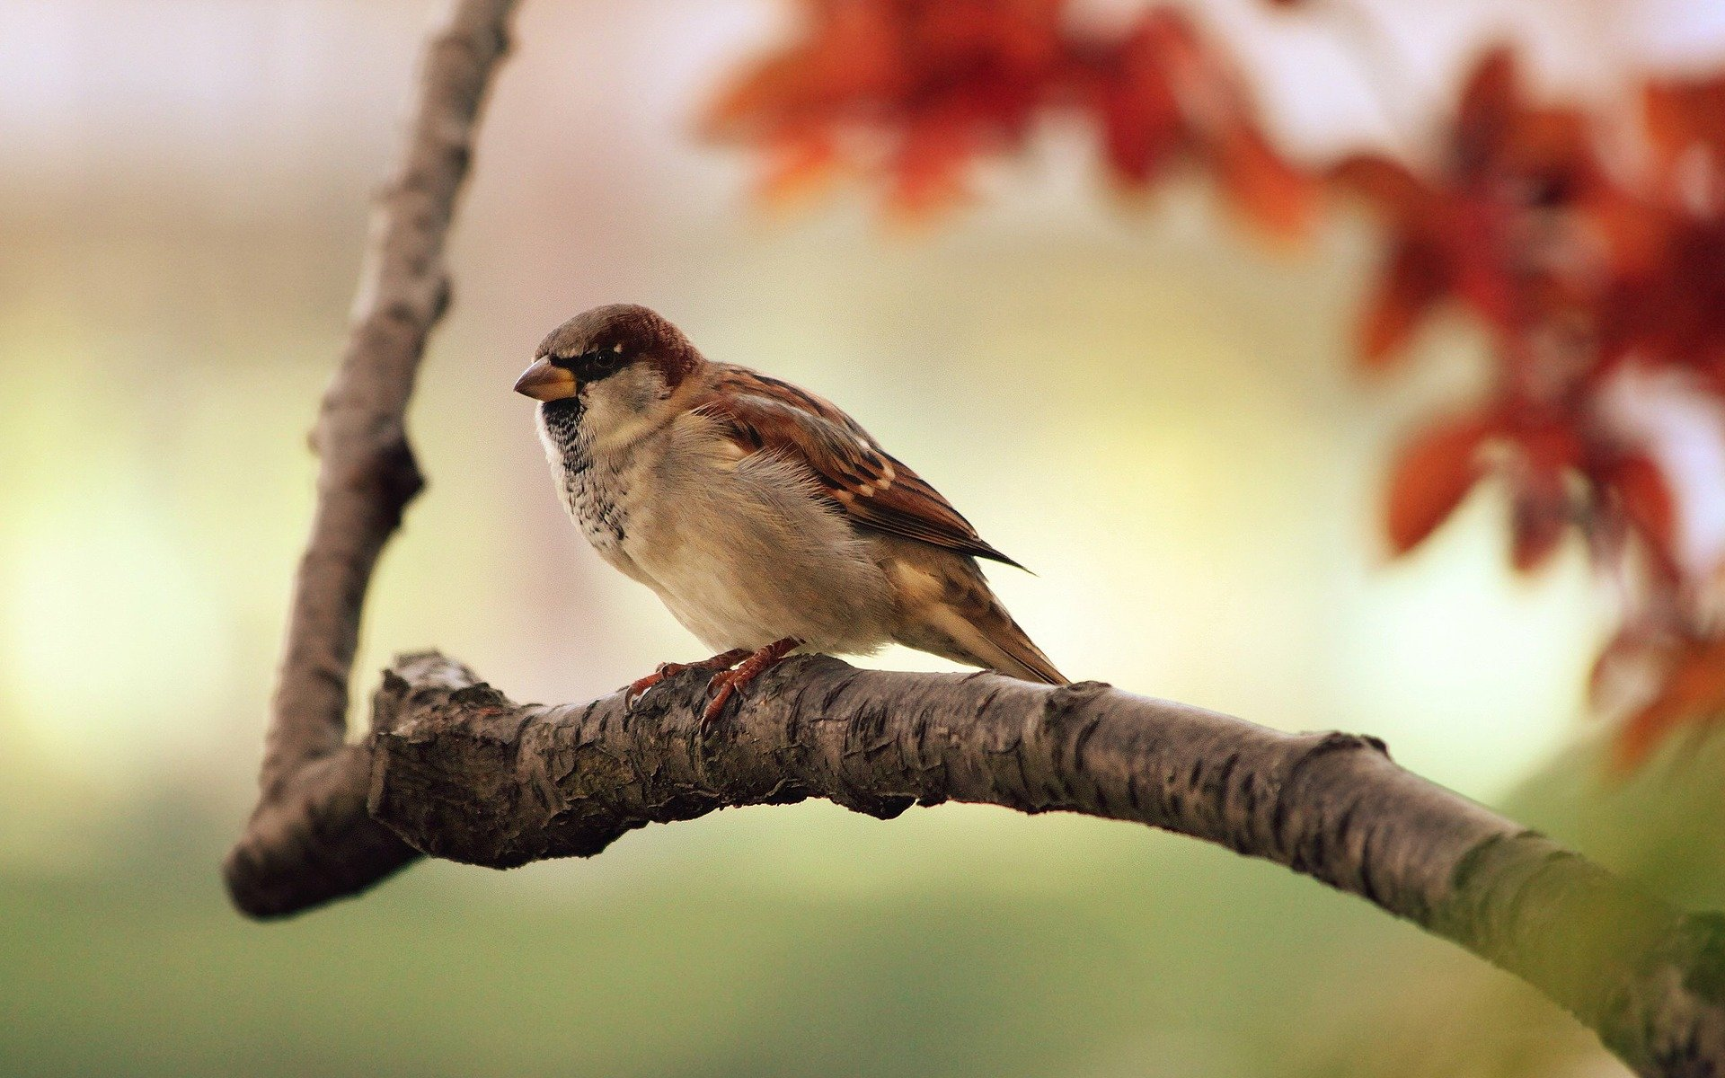
WHY THIS PROJECT? - JUSTIFICATION
The environment contains a lot of acoustic data that tells a lot about what is happening around.
I propose to use birds as my species of interest
By deploying acoustic sensors that listen to the biodiversity of an ecosystem, we can monitor the health of that ecosystem.
Notes:
And in a vast ecosystem having a rich biodiversity, we have to select an indicator animal because the status and trends of animal diversity and population levels of the selected indicator species is a good assessment of the ecosystem’s health.
Our best selection is birds because birds vocalise frequently and they live in most environments occupying every available habitable space in those environments
And so we can be able to monitor the health of the ecosystem by deploying acoustic sensors that can be able to listen to the biodiversity of that ecosystem.

Slide 4
WHAT IS AN ECOSYSTEM
An ecosystem is all the plants and animals that live in a particular area together with the complex relationship that exists between them and their environment.
~ Collins Dictionary
WHAT MAKES UP AN ECOSYSTEM
All living things e.g. lion king, birds, TMNT, frogs.
Non-living things e.g. River

Slide 5
tinyRANGER SYSTEM

Slide 6
WHAT WILL IT TAKE?
1
Design and Train a bird audio classification model
To design and fabricate a low cost, efficient, non-invasive, real-time ecosystem monitoring system
Design and build firmware for ML inference and wireless communication
2
3
Assemble hardware and test out the system
Notes:
This it will do by detecting and classifying different bird species and send the classification of the bird sounds to a dashboard for long term monitoring
Which I will choose to call tinyRANGER.

Slide 7
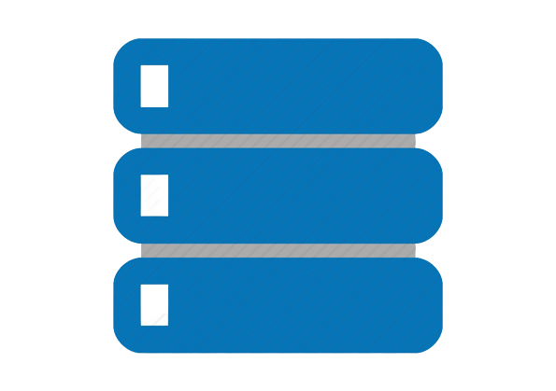
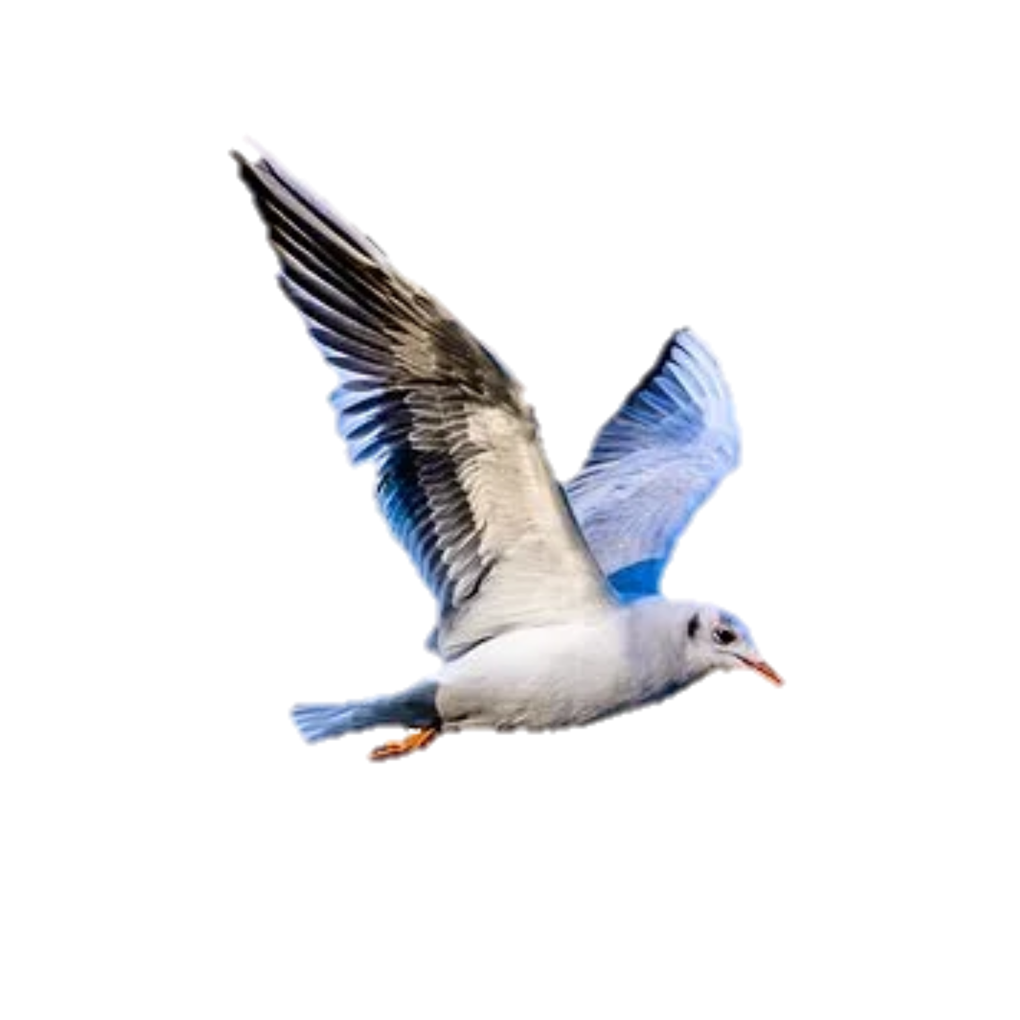
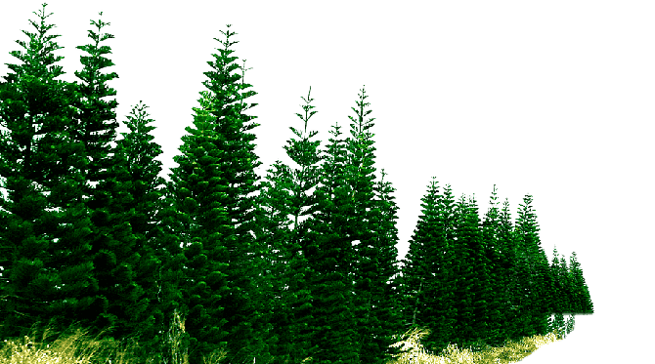
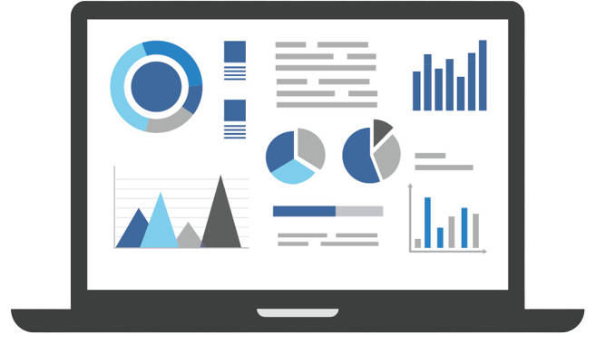
SYSTEM
ARCHITECTURE
Database storage
AWS
Endpoint - APIs
Decoded Payload
"payload": {
R "bird":“Species“
}
GCP
App services
tiRA device:
RP Pico
PDM microphone
RFM96 TxRx
Azure IoT hub
Byte payload
Uplink
Bird
Bird Sound
Uplink
Byte payload
Ecosystem
LoRaWAN gateway
Dashboard

Slide 8
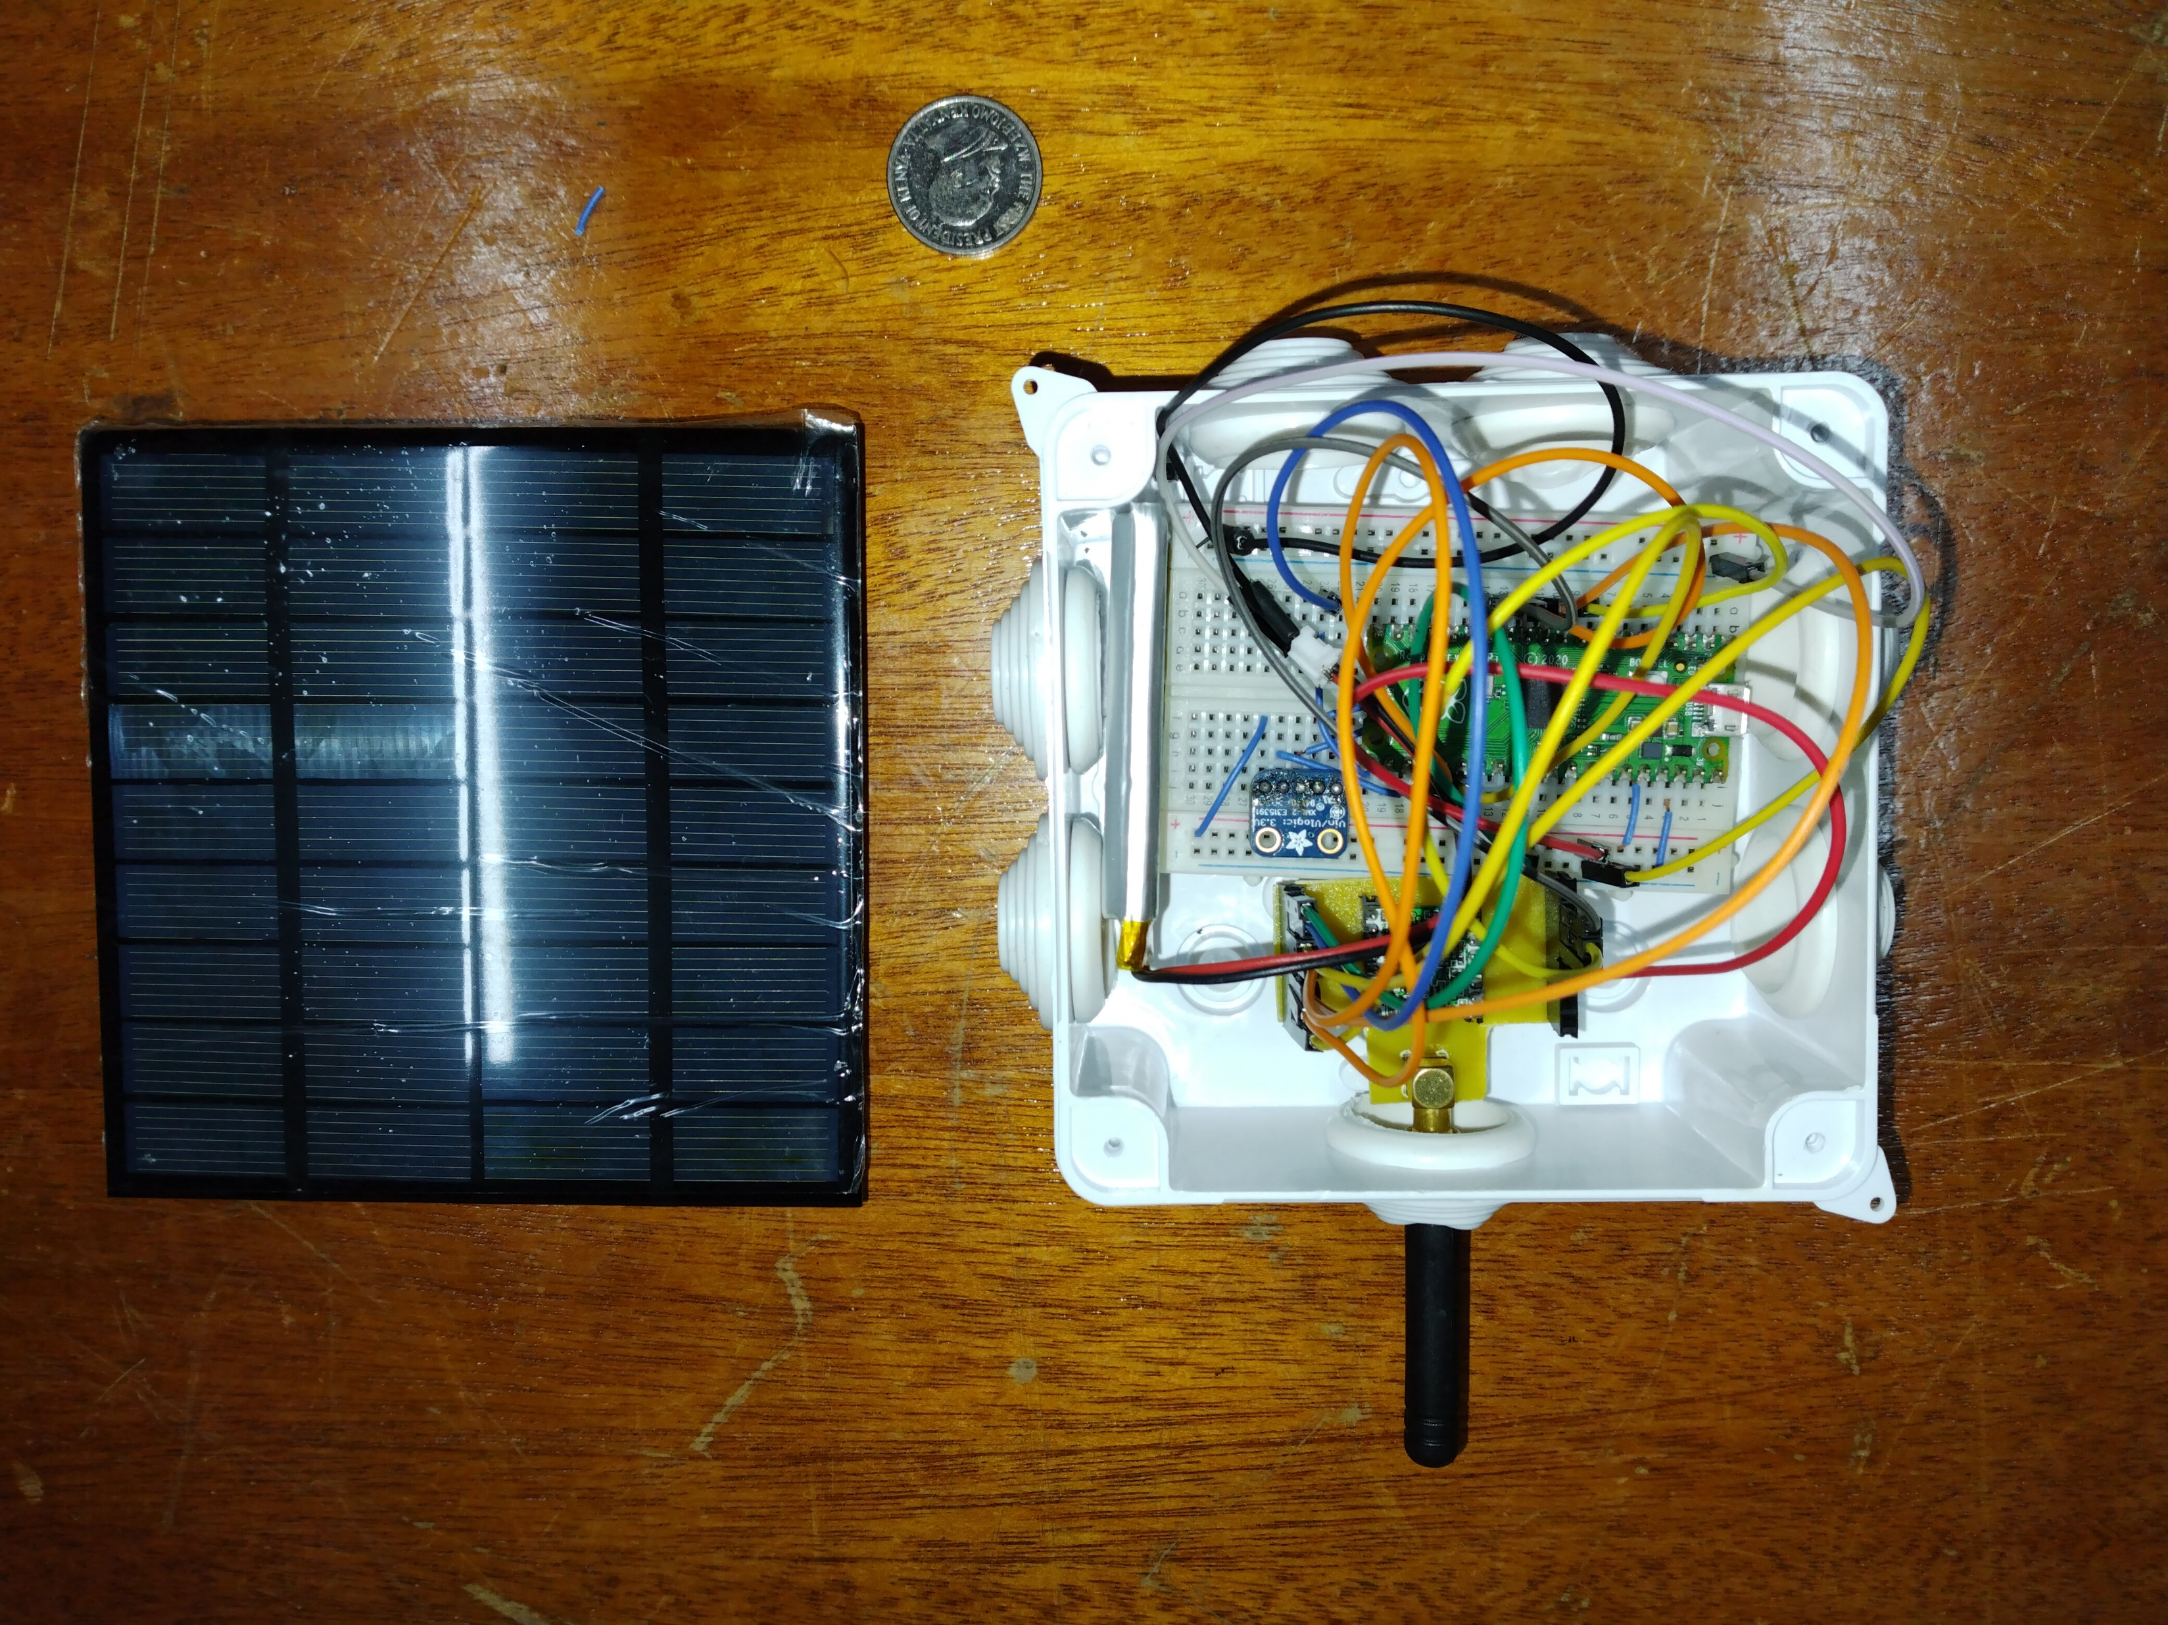
HARDWARE
Antenna
RFM Transceiver
PDM MEMS Microphone
RP Pico
Solar Panel
Enclosure
LiPo Battery
Notes:
Antenna: The antennas used for LoRa are mostly monopole and that’s what I’m using here.
Solar Panel: The communication between a node to the LoRa gateway is done in an energy-efficient manner and is ideal for battery operated devices over long distances
Solar Panel: Mini 9V 2W 222mA Solar Panel
It can last upto 21 hours when continuously sampling and running inference on data on a single charge. It consumes 93mAH and transmission is an extra 4.2mAH

Slide 9
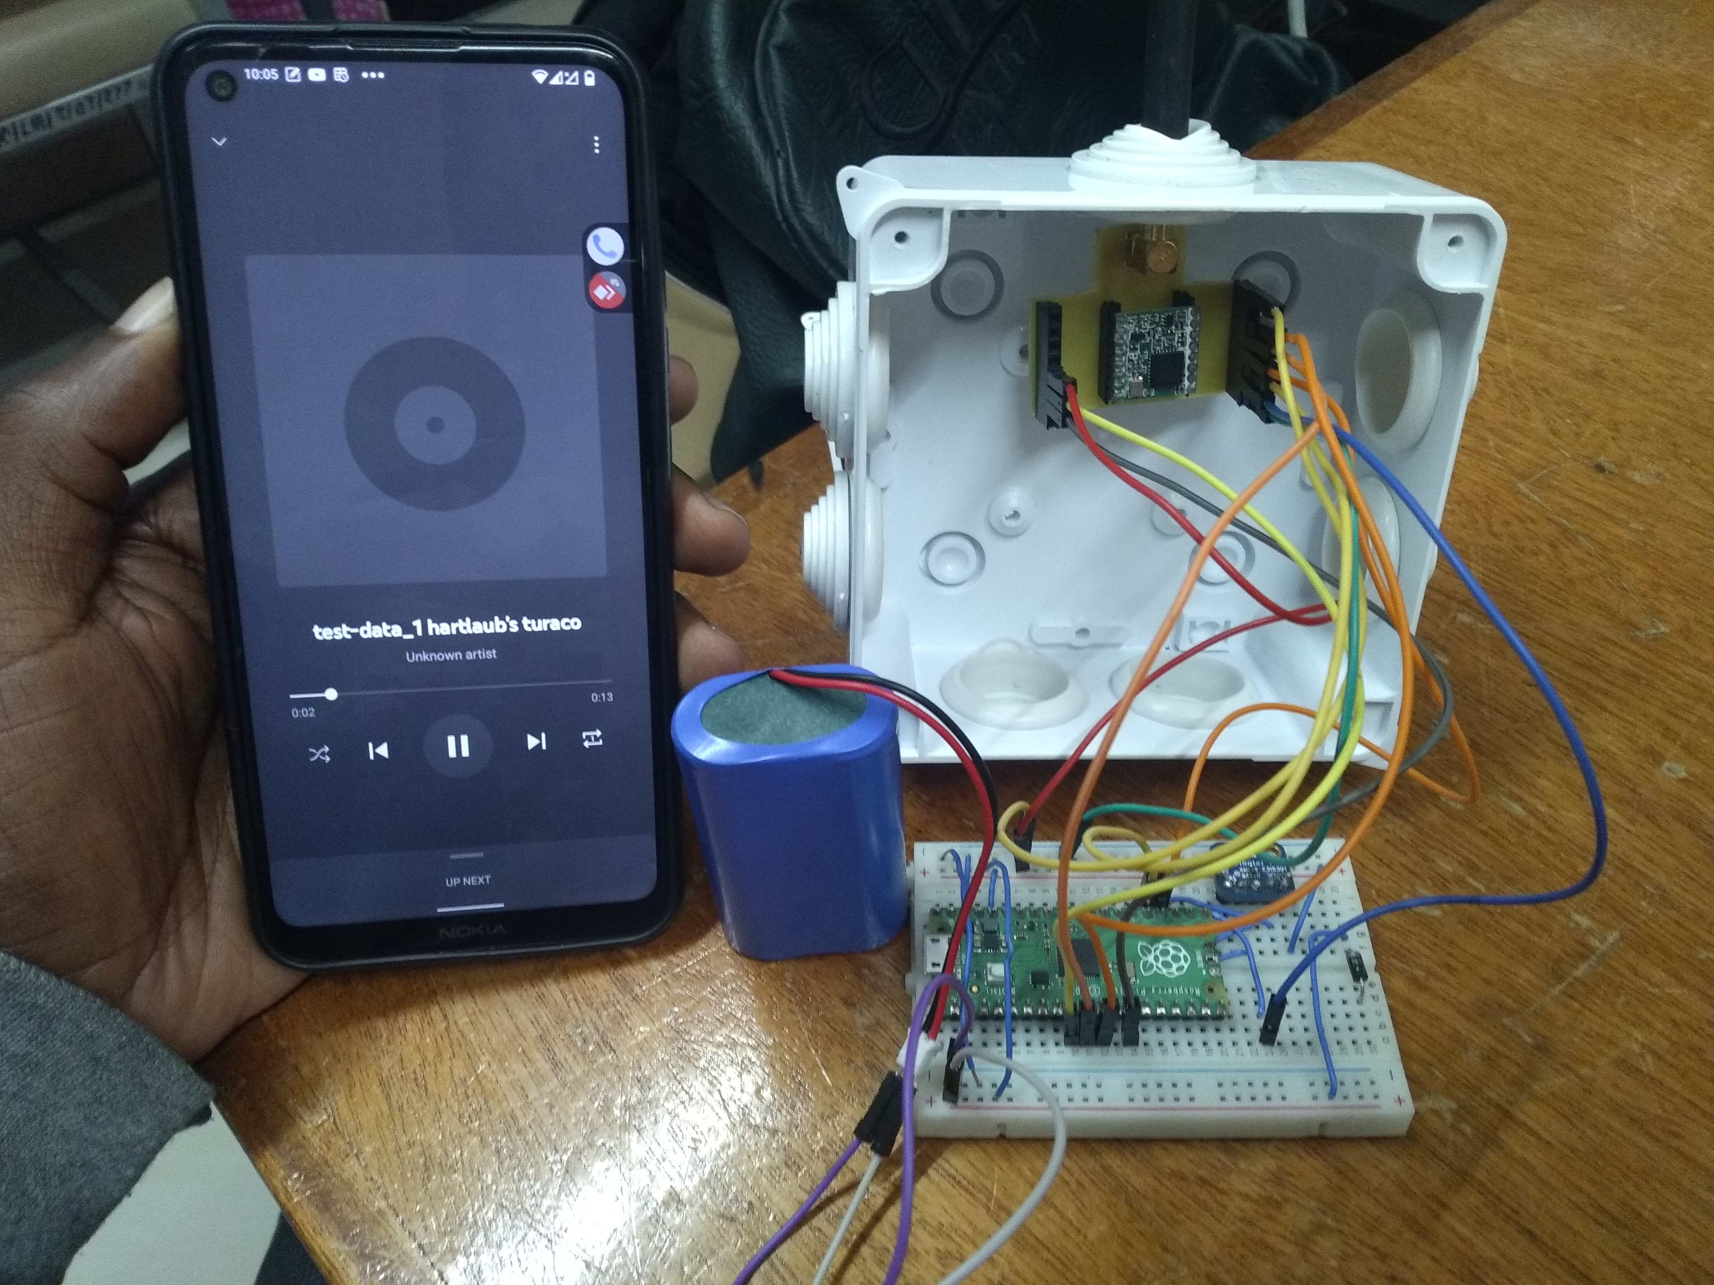
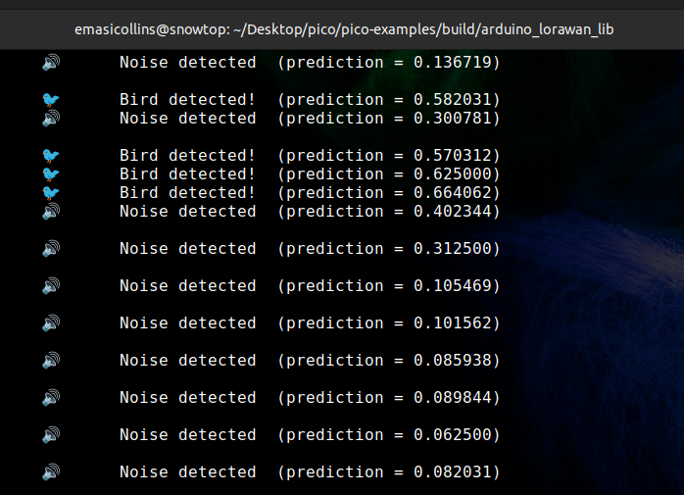
TESTING

Slide 10
NEXT STEPS
Careful power consumption analysis of the system for optimization
Bring together the ML Inferencing part to work together with the wireless communication in the RP Pico
Build dashboard for display of the analyzed data in a graph
Use microphone with higher gain
Deployment of the device out in the wild for testing on real day to day data
Notes:
I was able to test on a few audio prerecorded by the DSAIL Bioacoustics system.
Data is being successfully transmitted from the device to the cloud.

Slide 11
THANK
YOU

