Slide 1
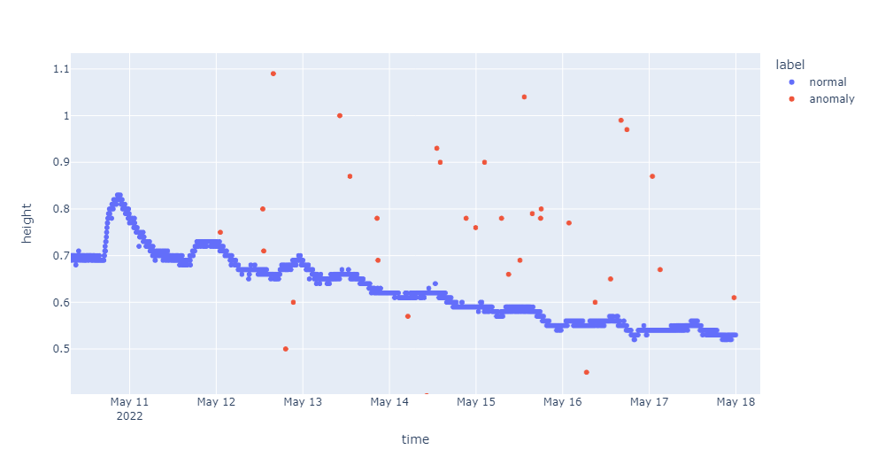
Research Day 2022
anomalies
LSTM Autoencoder Anomaly Detection for Time Series Data

Slide 2
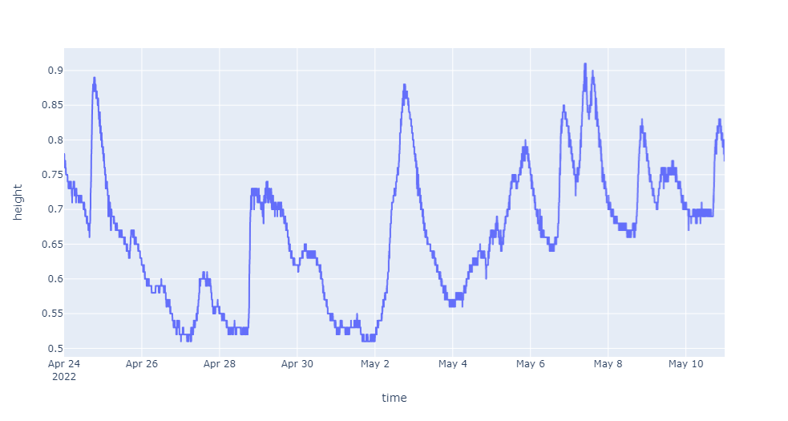
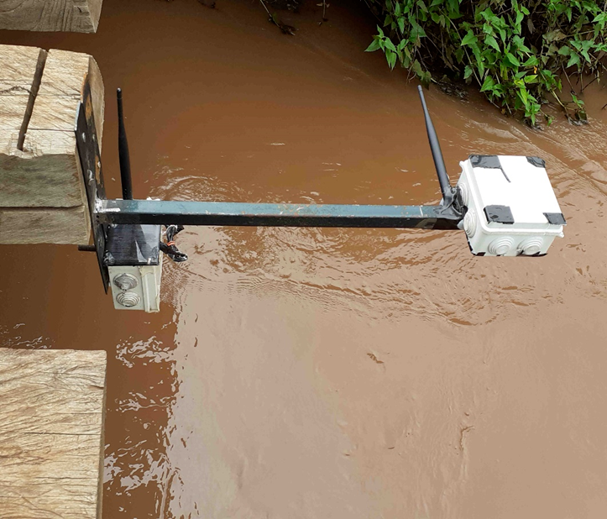
Definitions
Time Series Data:- It is a sequence of data points collected over an interval of time in this instance collected by IoT sensors which are deployed along River Muringato to capture water level and transmit the data in real time.
Water Level Sensors

Slide 3
Definitions
2. Anomaly / Outliers:-
An anomaly is simply unexpected change of data patterns, or an event that does not conform to the expected data pattern.
As a result, there is a need for automated quality assurance and control (QA/QC) of data, which can be accomplished via anomaly detection at edge level.

Slide 4
Anomaly Detection
UNSUPERVISED DETECTION METHODS
• Statistical methods assume that the data can be modeled from a specific distribution •
Anomalous if probability is less than threshold
• Proximity methods use distance to define anomalies.
Anomalous if distance from centroid greater than threshold
• Deviation methods use lower-dimensional embeddings and reconstruction error
Anomalous if reconstruction error is greater than one or standard deviation
APPLICATIONS
Finding anomalies can be useful in
Telecom networks
Cyber security
Finance
Industry,
IOT
Healthcare
Video surveillance
Robotics. etc

Slide 7
Implementation

Slide 8
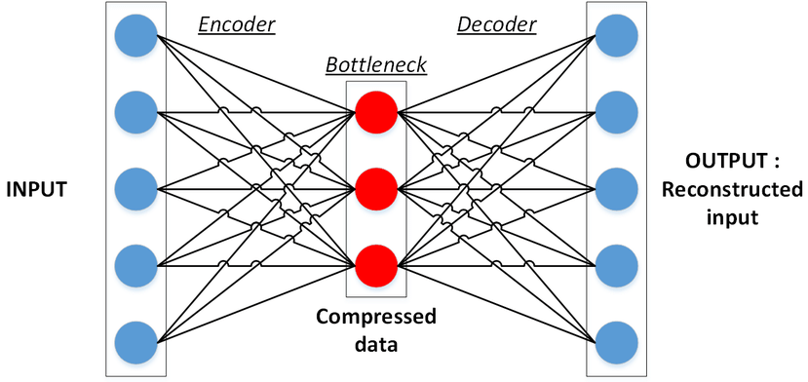
LSTM AUTOENCODER
Autoencoders are a form of unsupervised learning and have applications outside of anomaly detection
• An autoencoder consists of two parts the encoder and decoder
• Encoder is a neural network that maps the input to a (typically) lower-dimensional space
• Decoder is a neural network that maps the encoded data back to the input
• Anomalies have high reconstruction error

Slide 9
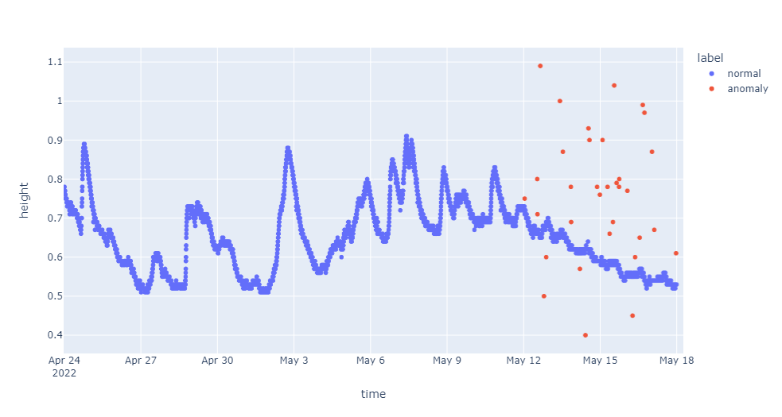
STEPS
Step 1:- Data Preparation
Loading the time series data
Drop any unnecessary columns
Convert time column to data and time
Visualize the time series data
Finally split the data into train and test data.

Slide 10
STEPS
Step 2:- Training the Autoencoder
Create Sequences of the training data in this case a Time_Step = 3
Build a LSTM Autoencoder to train the training data - Define reconstruction LSTM Autoencoder architecture that expects input sequences with 3 time steps and one feature, and outputs a sequence with 3 time steps and one feature.-

Slide 11
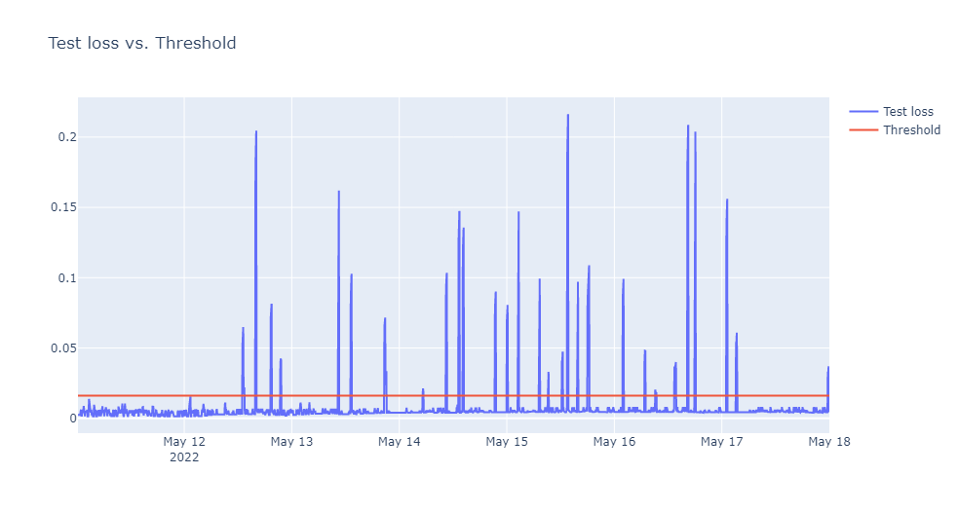
STEPS
Step 3:- Determine Anomalies
Find the Mean Absolute Error(MAE) of the training data
Make maximum MAE loss value of the training data as Reconstruction Error Threshold
If Reconstruction loss of data point in test > Reconstruction Error Threshold the value will be labelled Anomaly
Reconstruction Loss of test data

Slide 12
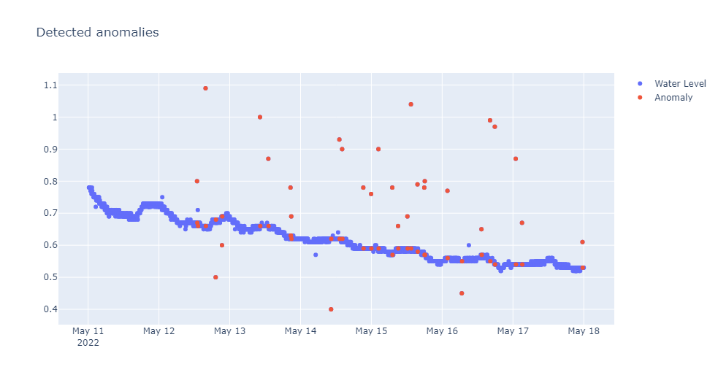
STEPS
Step 2:- Determine Anomalies

Slide 13
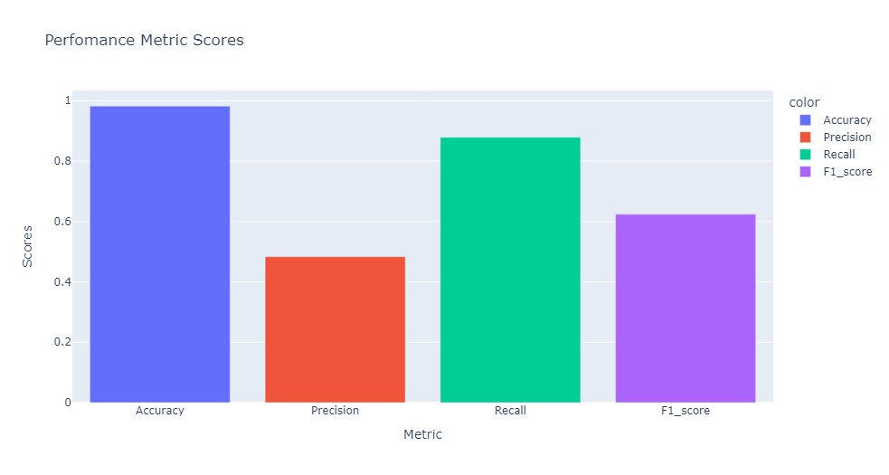
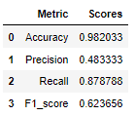
STEPS
Step 4:- Performance Metrics
To determine how our model performed we will perform various evaluation metrics such as:
Accuracy
Precision
Recall
F1 Score

Slide 14
THANK YOU FOR LISTENING

