Slide 1
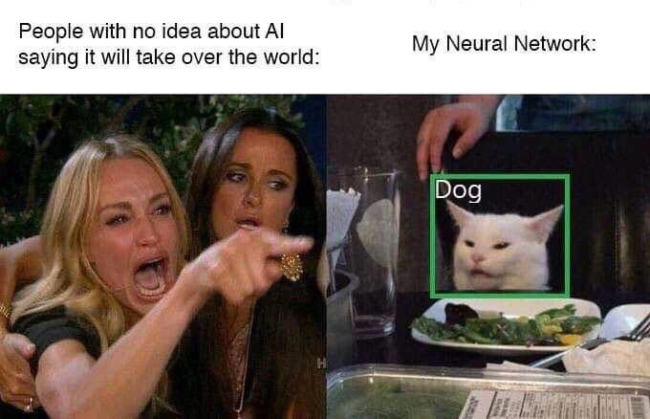
Real-Time Object Detection with YOLOV5

Slide 2
Introduction
Object detection is a process of computer vision of finding all the possible instances of real world objects in real-time with utmost accuracy.
YOLO V5, is a regression based algorithm of Torch.
YOLOV5 predicts classes and bounding boxes of an image in one run.
The major objective is to able to detect the different animal classes of the DSAIL Porini Dataset that was collected from school’s conservancy.

Slide 3
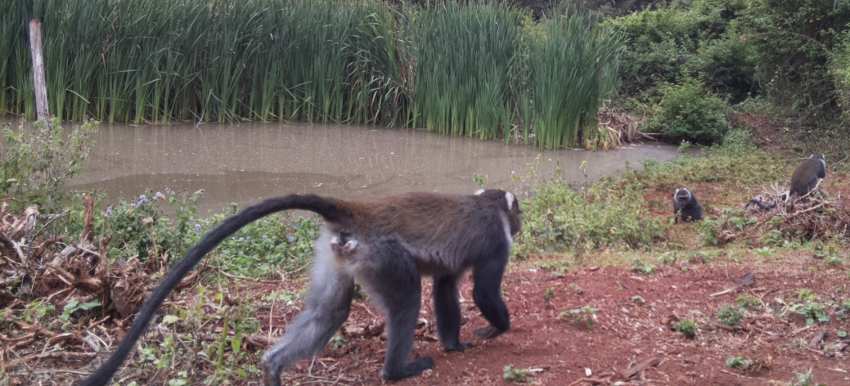
DSAIL Porini Dataset
The DSAIL Porini Dataset contains 8524 annotated images of animals that belong to 6 classes
Impalas,
Warthogs,
Zebras,
Monkeys,
Waterbucks
Bushbucks.

Slide 4
Preparing the Dataset
The most important step is in preparing the dataset is in labeling the Images for training by drawing bounding boxes for each object
Each box contains five major attributes;
x and y coordinates
Height and weight of the object
The confidence score

Slide 5
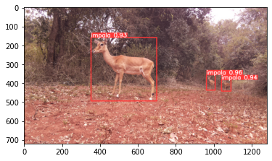
Training and Inferencing

