Slide 1
Processing of Bio-acoustics Recordings for Ecosystem Monitoring -a case of bats
Muhinyia Ndegwa
Center for Data Science and Artificial Intelligence(DSAIL)

Slide 2
Why Does It matter?
The structure and functioning of ecosystems are changing at an unprecedented rate. Ecosystem monitoring is critically important to understand the changes in the ecosystem and subsequently inform the best conservational strategies to employ.
For successful ecosystem monitoring, it is important to identify and consider bio indicators that respond promptly to parameters under consideration. Here we use bats.
Monitoring of ecosystems with bats as the ecological indicators is a task involving audio analysis.
By deploying recorders in the ecosystem, it is pretty easy to obtain hours of audio recordings. However, the recordings will constitute all manner of sound activities.
The goal is to filter for and localize bat calls from these mixed up recordings.

Slide 3
Why Bats?
Bats as bio-indicators – Bats are sensitive to changes in their habitats. This qualifies them as excellent bio indicators in research.
Bats as pollinators – some bats drink nectar and in the process enhance cross-pollination
Bats as seed dispersal agents – Fruit bats facilitate seed dispersal to a distance of up to 75km from roost sites.
Bats for pests control – On a typical night, insectivorous bats consume 50-100% their body weight in insects. This insect-heavy diet helps foresters and farmers in pests control.
Scientific Inspiration - Bat's unique features such as echolocation trait and membranous wings have inspired technological advances in engineering e.g. Drones fabrication, sonar systems navigation.
Disease Agents – Bats are not without their shortcomings. They have been identified as a major reservoir of zoonotic viruses of various families including SARS-Coronavirus, Rabies virus, Ebola, etc.
Notes:
2. Over 300 species of plants including mangoes, bananas, avocadoes depend on bats for pollination.
4. In Brazil, a free-tailed bat has been recognized as an important insect management service in cotton farming.

Slide 4
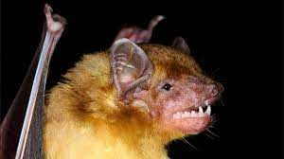
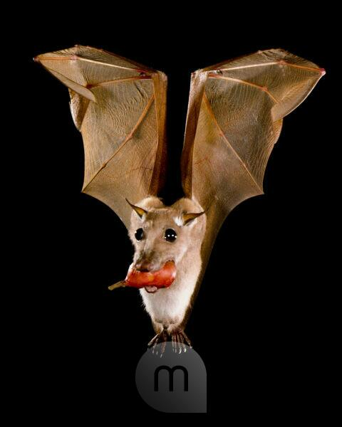
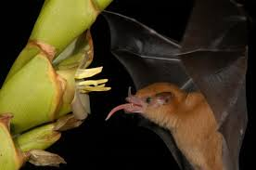
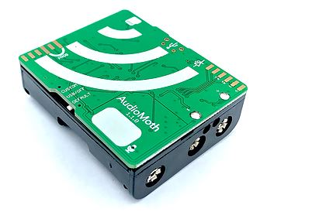
Why Bats?
Notes:
Epomophorus labiatus

Slide 5
The Processing Pipeline
Audio recording
Audio array
Compute Spectrogram
Denoising
Detect bat Calls
Audio Recordings
The input to this pipeline are WAV files obtained by deploying AudioMoth recorders in the ecosystem.
We use the librosa library to load the WAV file into an audio array.
Spectrogram Computation
Very little can be said about a signal’s frequency while in the time domain as it only shows the amplitude as the time varies.
Spectrograms show the array of frequencies of a signal and their variations with time. This makes it possible to analyze the frequency content of a signal with respect to time. Such a signal is said to be in the frequency domain.
Transforming a signal from time to frequency domain is through Fast Fourier Transform(FFT). Short Time Fourier Transform (STFT) which uses a sliding window FFT is used to avoid information loss.

Slide 6
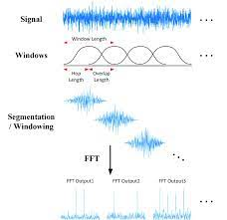
Stft computation

Slide 7
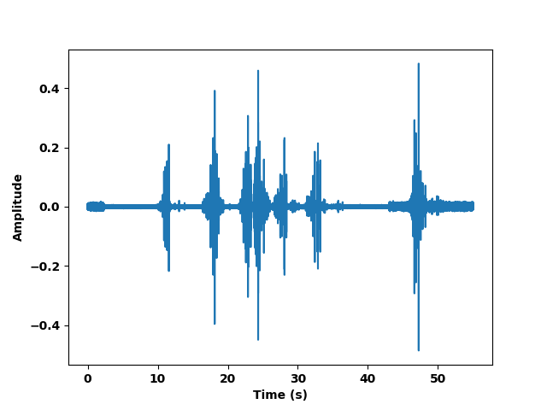
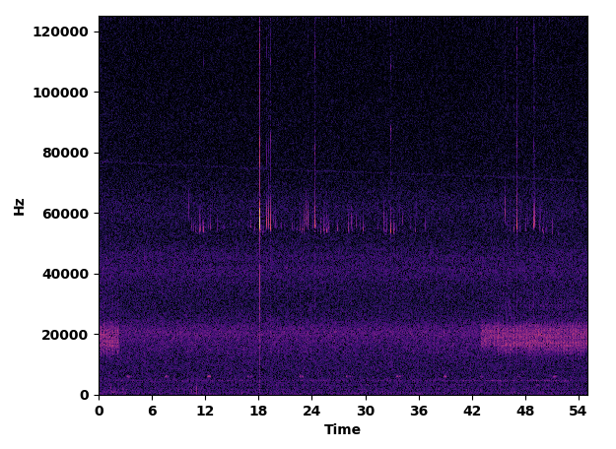
Audio Signal
The equivalent spectrogram

Slide 8
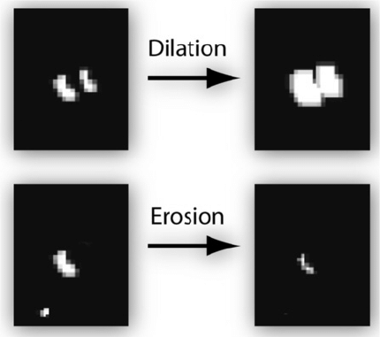
Denoising
To reduce noise in the lower frequency bands, we eliminate spectrogram pixels that are smaller than some threshold times the median. Pixels meeting this criteria are set to 1 and 0 otherwise. The results of this process is a binary mask.
For precision, the mask is subjected to closing (a dilation followed by erosion).
Dilation adds pixels to the boundaries of objects in an image, while erosion removes pixels on object boundaries.
Notes:
Closing removes small holes i.e. removes sparse 0

Slide 9
Calls Detection
To detect bat’s call activity the algorithm executes the following steps:
Components extraction – the algorithm processes the binary mask and obtains the regions with series of 1s. These corresponds to the regions of interest in the recording.
Elimination of short components – short component are series of 1s whose length does not meet a desired threshold (10ms in this case). Components whose duration is lesser than this threshold are considered to emanate from other sources than bat calls. Components meeting this threshold constitutes a call pulse.
Group close components together – components occurring together comprise a call. The closeness here is defined by inter-pulse duration (500ms).
Elimination of solitary components – components that does not belong to a group are dropped. A call activity cannot contain a single pulse.
Notes:
Closing removes small holes i.e. removes sparse 0

Slide 10
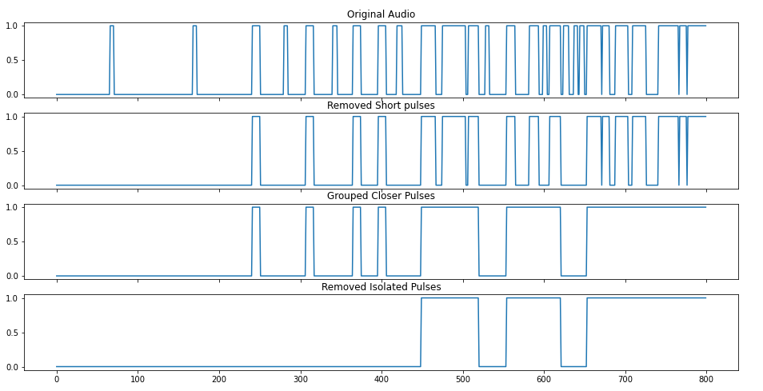

Slide 11
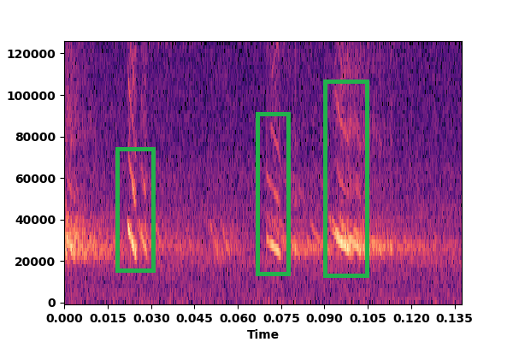

Slide 12
Thank you

