Slide 1
Comparison of a wearable and human pose based model in knee flexion angle measurement for orthopedic Patients
By: Dr. Ciira Maina
Dr. Wanjema
Victor Kulankash
Anthony Gitau

Slide 2
Overview
Introduction
Primary goal
Justification
How it Works
Requirements Specifications
Analysis of Results
Conclusion

Slide 3
Introduction
The research includes design and implementation of:
A wearable device that measures knee flexion angle
Implementation of a human pose model to determine the angle of joint flexion
Primary Goal:
To determine the angle of flexion of a joint within it’s effective Range of Motion and also monitor the recovery of orthopedic patients.

Slide 4
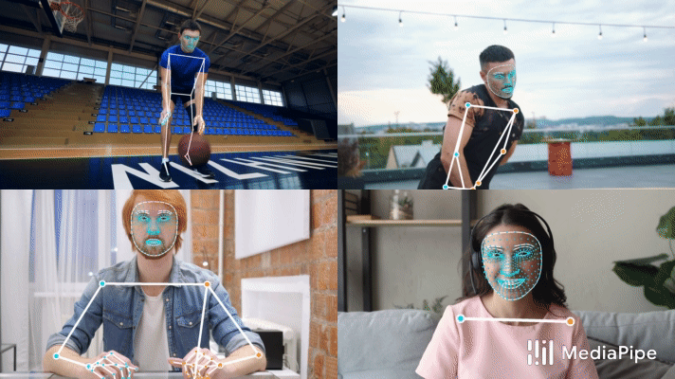
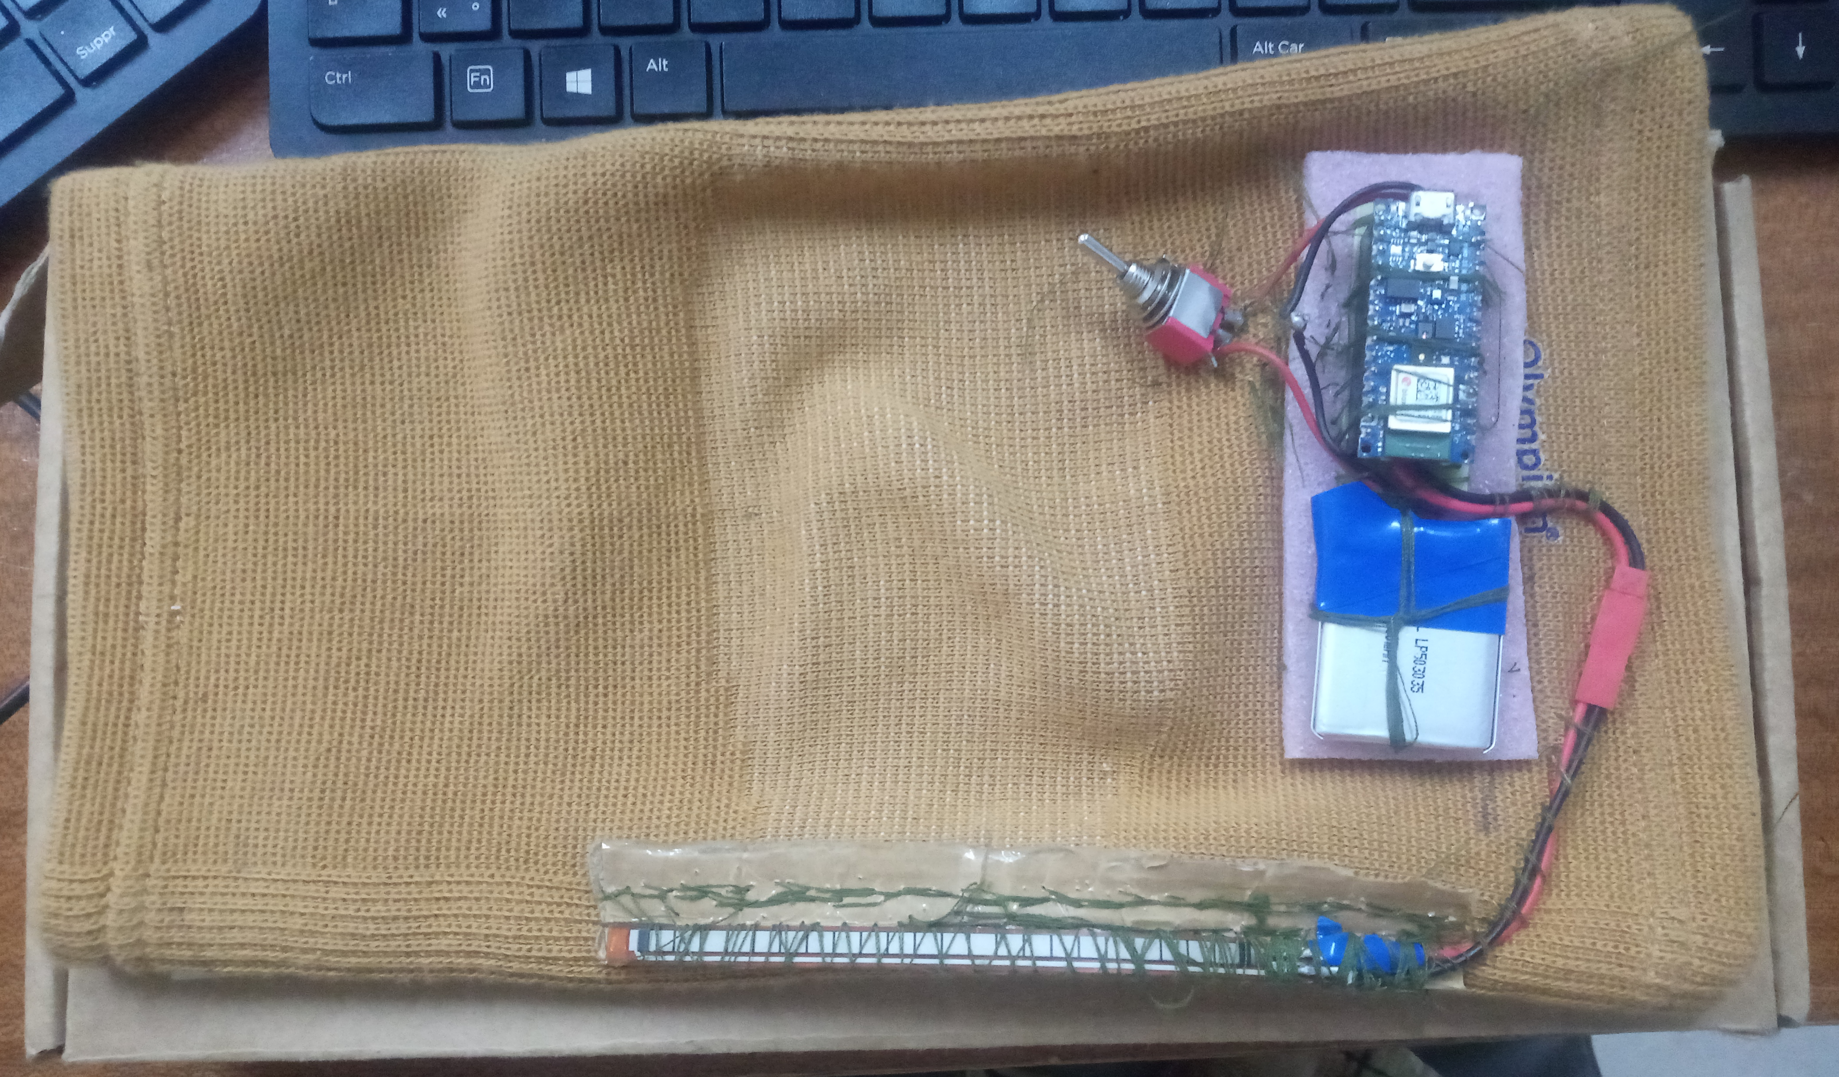
I. Wearable Knee Flexion Angle measurement Device
II. Human Pose Model In various Applications

Slide 5
Justification for the research
Main Aim:
Tracking recovery of Orthopedic Patients after knee replacement surgery(TKR) without invasive methods that are technologically advanced in terms of data collection and data logging.
Others:
Gait Analysis for patients
Computer Vision in Human Pose tracking
Monitoring effective range of motion of a joint or limb

Slide 6
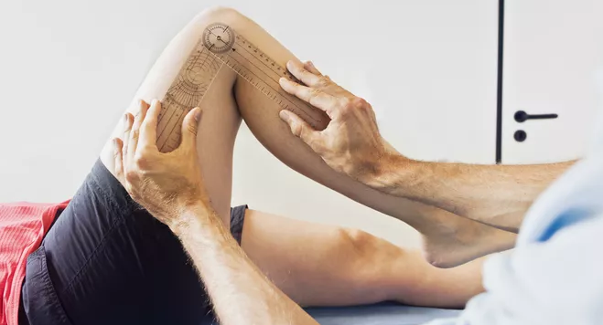
Current solutions in measuring range of motion(rom) of a joint
Drawbacks:
Invasive to patient
Involves manually recording data
Relies on the accuracy of the clinician (prone to human errors)
Tracking of progress in recovery is also done manually after interpreting and assessing data
Orthopedic Specialist using Goniometer to measure ROM

Slide 7
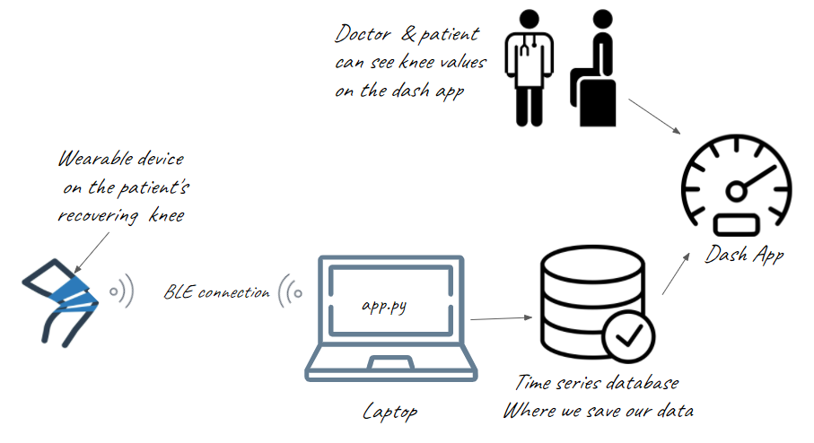
How it works
I. Wearable Device

Slide 8
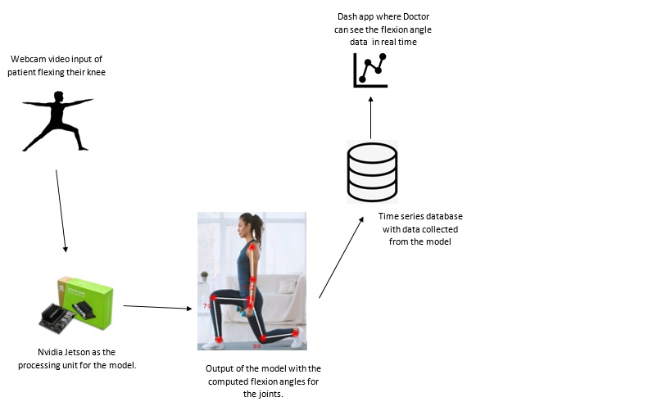
II. Human Pose Model

Slide 9
Reasons for using Jetson Nano
Small Footprint with decent processing capability
Utilization of NVIDIA’s GPU cores
Multi-Parallel task operation advantage of GPUs in solving Matrix Multiplications
Optimization that can be done by Nvidia’s Torch2TRT i.e. utilizing CUDA cores in processing
Integration to multiple accessories and devices

Slide 10
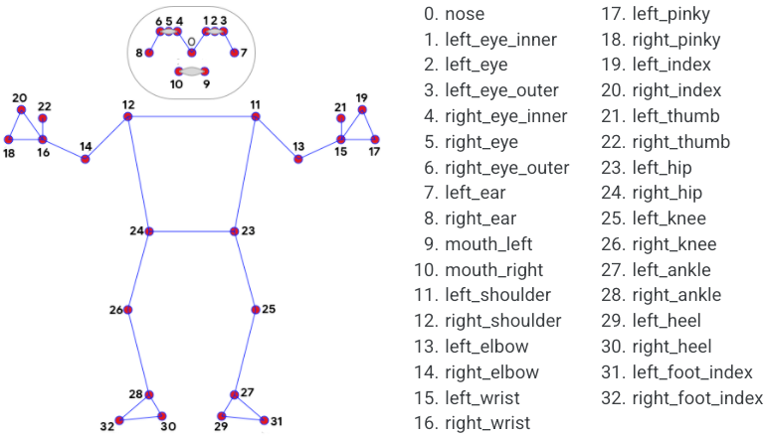
HOW the model works
Defined class poseDetector
defined function pose model (Mediapipe)
defined function joint tracker with skeleton linking up the joints
defined function pose angle i.e. (estimated skeleton gives angle of joints)
Joint | Pose Landmark joints to consider
Right Knee Joint | 24, 26, 28
Left Knee Joint | 23, 25, 27
Right Elbow | 12, 14, 16
Left Elbow | 11, 13, 15

Slide 11
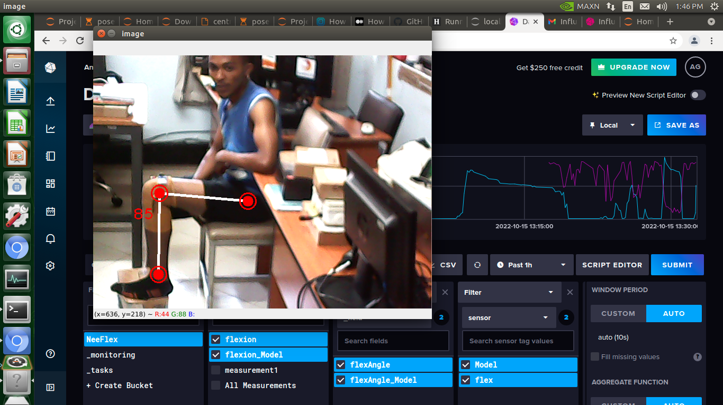
Data collection
Flexion angle data acquisition from the wearable device and the pose model logging of data into an online database (InfluxDB)

Slide 12
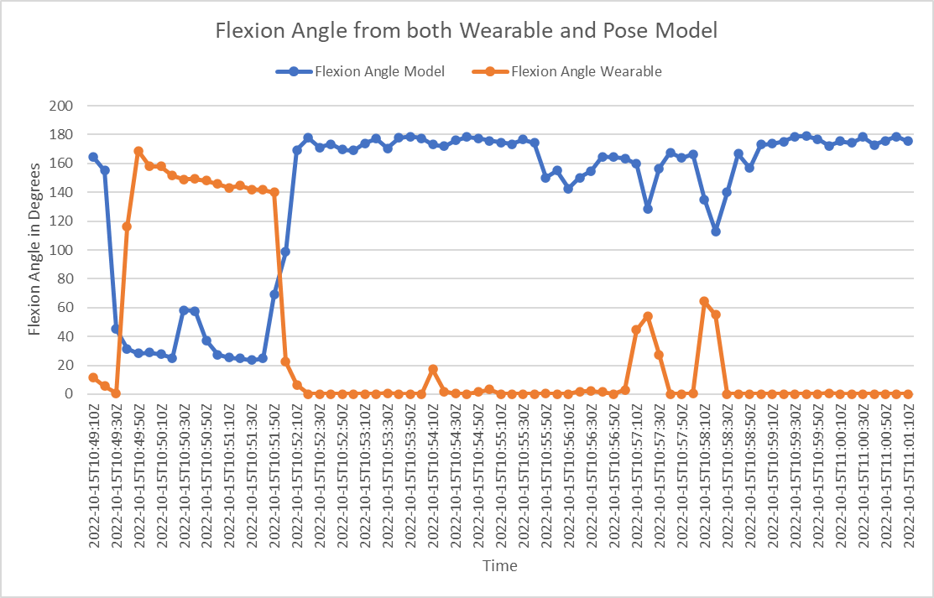
ANALYSIS OF RESULTS
Comparison of Knee Flexion Angle values obtained

Slide 13
SUMMARY
We were able to obtain the angle of knee flexion from both the wearable device and the human pose model running in real time.
We were able to record the data in a database for comparison and analysis such that we have the flexion angle at each specific time both readings were recorded.
Next goal is to optimize the model to be able to work at a higher framerate on the Jetson Nano.

Slide 14
THANK YOU.
Presented by: Victor Kulankash
www.linkedin.com/in/victorkulankash

