Slide 2
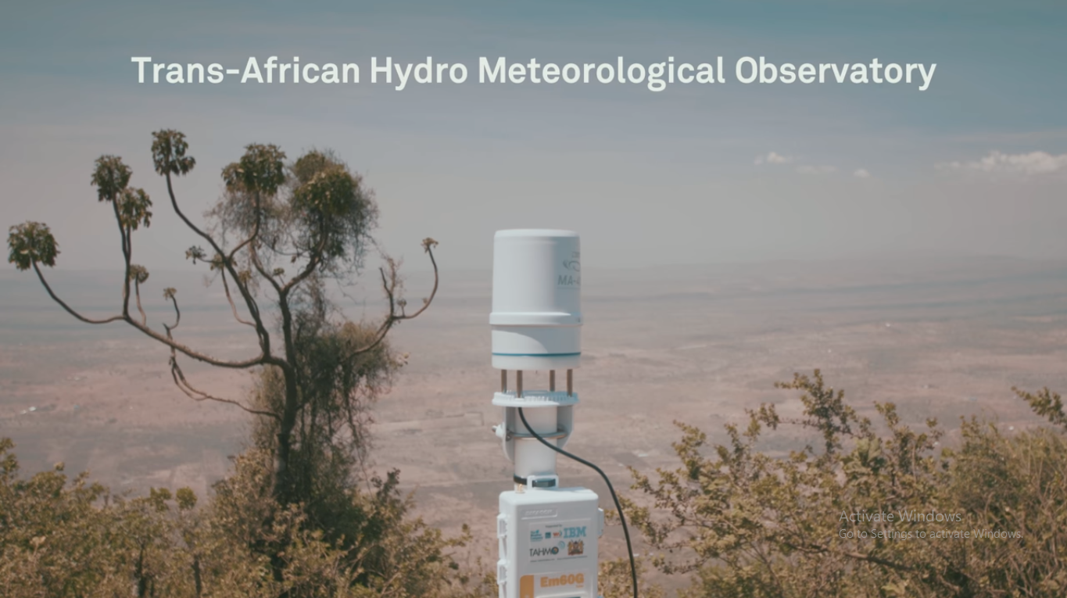
The Trans-African Hydro-Meteorological Observatory (TAHMO) aims to develop a vast network of weather stations across Africa. Current and historic weather data is important for agricultural, climate monitoring, and many hydro-meteorological applications.

Slide 3
Background
The challenge of the coming century is how to feed ourselves with the currently depleting groundwater and the growing population
How are we to grow more food on the same land Earth has?
Turns out 60% of land that can grow crops is here in Africa
What keeps the African farmer from realizing their potential?
Lack of access to information and so we’re solving problem of getting climate data into the farmers hands

Slide 4
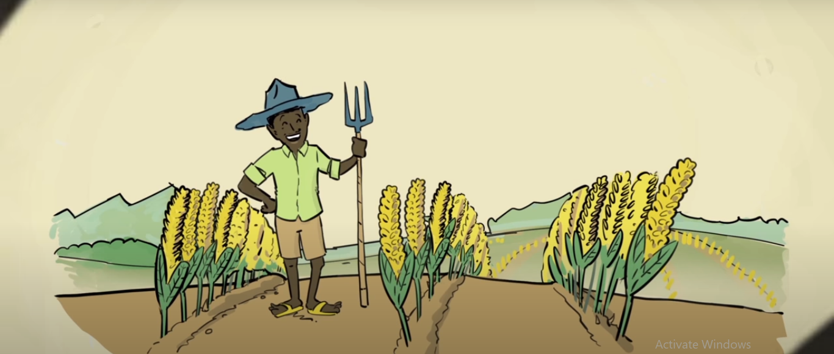

Slide 5
Relevance
Monitoring Africa’s environment is an important challenge if the continent’s resources are to be used in an optimal and sustainable manner. Food production and harvest predictions profit from improved understanding of water availability over space and time.
Presently, African observation networks are very limited, and national governments and regional planners do not have the data to make proper decisions regarding investments in water resources infrastructure.
Ground data combined with satellite data and computer models to help improve weather predictions
By estimation, water productivity can be improved by 26% with better predictions
Additionally, weather stations are expensive to maintain, however, TAHMO has designed a cheap but efficient weather station by making use of readily available sensors that are low maintenance and cheap

Slide 6
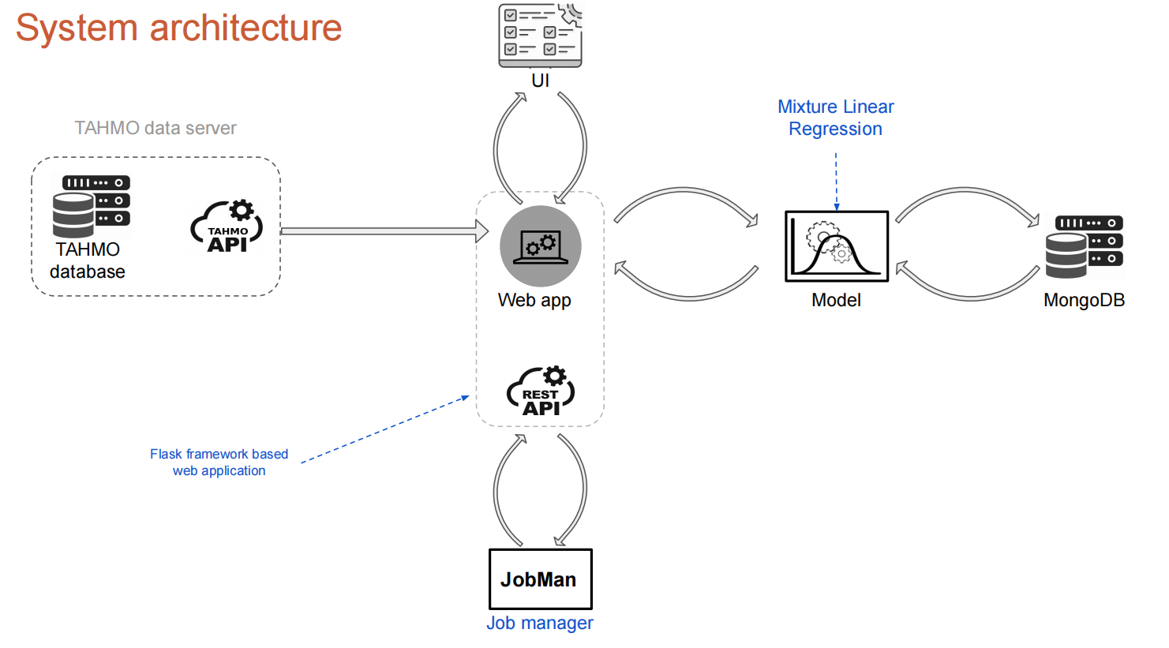

Slide 7
RainQC Main Procedure
● Model Training task: Use available historical data at each station and its
neighbors to fit an anomaly detection model, used to assess (score) the
quality of future sensors reported data.
● Model Evaluation task: Use a validation dataset to determine an anomaly
detection threshold for each trained model.
● Station/model scoring task: Use a trained model to predict the expected value
at each station, then compute an anomaly score based on the dissimilarity
between prediction and observed data.
The model training and evaluation process happens after a particular stride when developing a new model happens
The model scoring happens on a daily basis when running a job
Data completeness check for training procedure
Current system requirement:
● Neighbors selection radius: 100km
● Min and max number of neighbors: 1 and 5
● Minimum of 15 days per month (180 days). At least half a month of
simultaneously complete precipitation (daily completeness) at the target
station and its neighbors.
● Minimum of 260 out of 288 daily expected values (sensors record
precipitation at 5-minute interval - i.e., 288 records in 24h). More than 90% of
the expected data is required to consider a station complete for a given day.

Slide 8
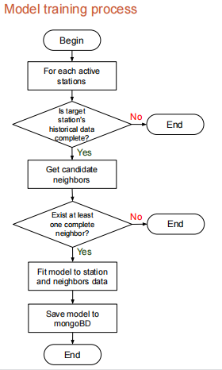
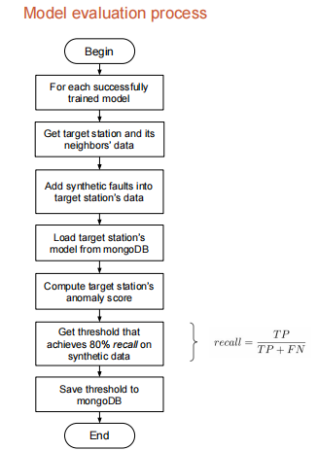
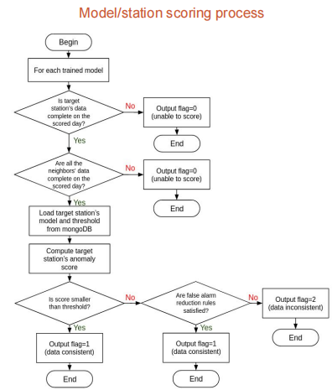

Slide 9
What happens when running a job?
From these evaluated models, they undergo a scoring process
The current anomaly detection model is based on the aggregated precipitation data for a day. The data is collected after every 5 minutes hence the 288 from 12am to 11.55pm
What is a job?
A job is scoring an anomaly detection model for a single station on a single day and recording the results in the TAHMO system.
Scoring results in the TAHMO system only happens immediately when scoring succeeds (either get consistent data or data with inconsistent results)
If there is insufficient data to score the station, the job manager will retry a number of times on successive runs(AFTER 7 DAYS) of the job manager. If scoring doesn’t ultimately succeed, it will then store the results in the TAHMO system but with a different code that indicates insufficient data

Slide 10
Limitations
The limited number of weather stations in Africa is spread out over enormous distances; most are found in northern and southern Africa, leaving huge data gaps in the central part of the continent.
APIs failing, inability to retrieve data from the database
Additionally, at times the sensors fail resulting to incompleteness of data thus inconsistency in the model development.

Slide 11
Next Steps
Improve daily status messages
Support longer time intervals
Dynamic selection of neighbors

