Slide 1
DeKUT-DSAIL Research Day 21st Oct 2022
Deploying Tailor-Made IoT Solutions at The Grassroot
Jared makario
IoT Solutions Engineer, Newcore IoT

Slide 2
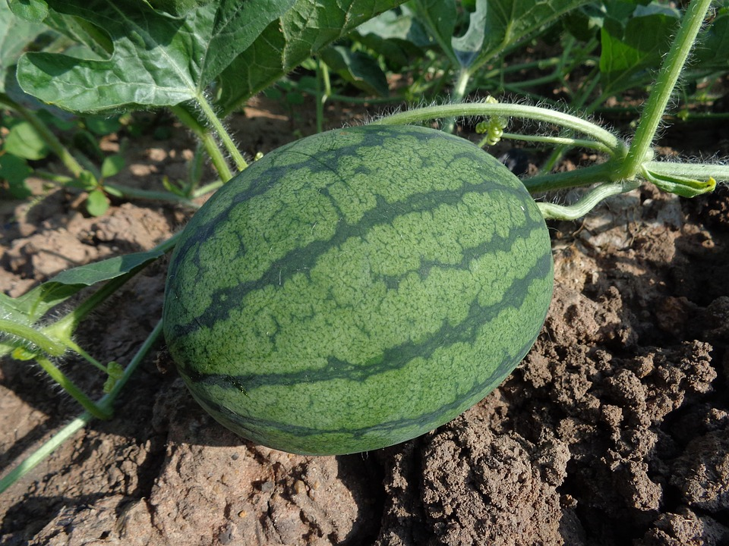
Industrial Verticals Leveraging LPWAN Technologies
IoT Solutions Focus Areas
Precision Agriculture
Climate Change
Livestock management
Wildlife conservation
Smart Water management
Fintech for SMEs
Asset tracking
Facility management
E.T.C
Figure 1: Precision farming need constant soil health and environmental parameter monitoring

Slide 3
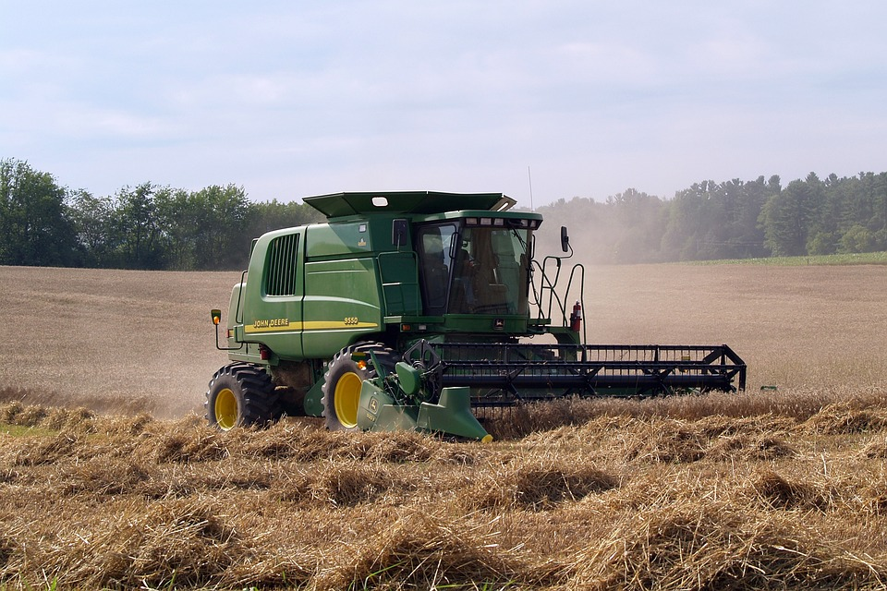
Figure 2: Food security and nutrition needs integration of effective technologies and farmer education
Figure 4: LPWAN based stoves cuts on fuel costs and carbon through wireless remote monitoring and control to save the planet
Figure 3: IoT solutions with data and modern trackers have cut down costs in mechanization increasing food production

Slide 4
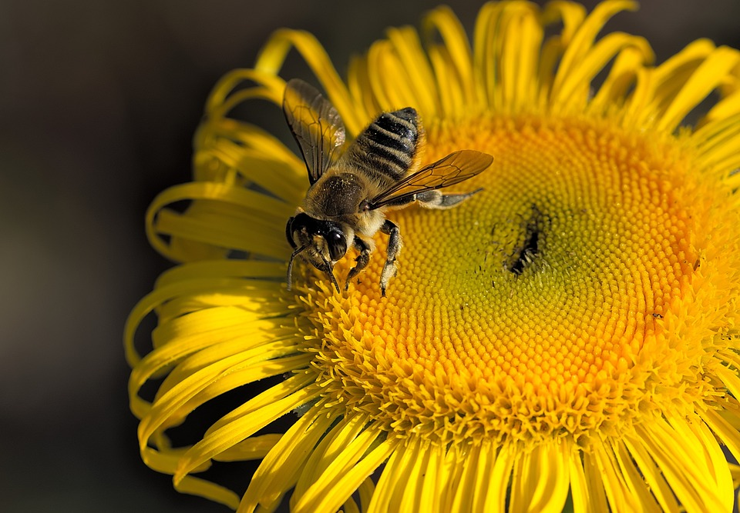
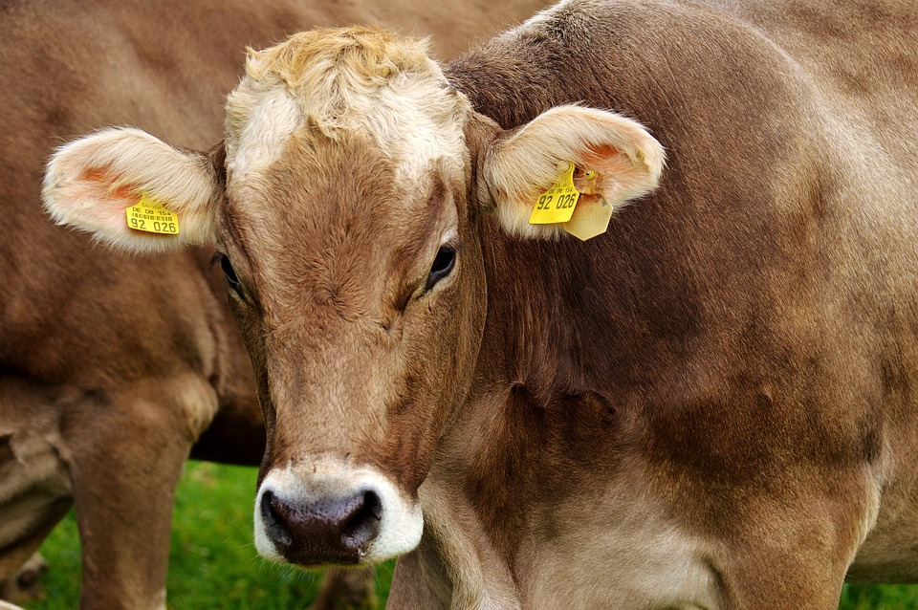
Livestock management
Wide range of stressors such as pests, diseases, pesticides, pollutants/toxins, nutritional deficits, habitat loss, effects of climate variability, agricultural production intensification, reduced species or genetic diversity has affected livestock.
Figure 4: A bee foraging for nectar on a flower
Figure 5: Livestock production, feeding, health and activity tracking

Slide 5
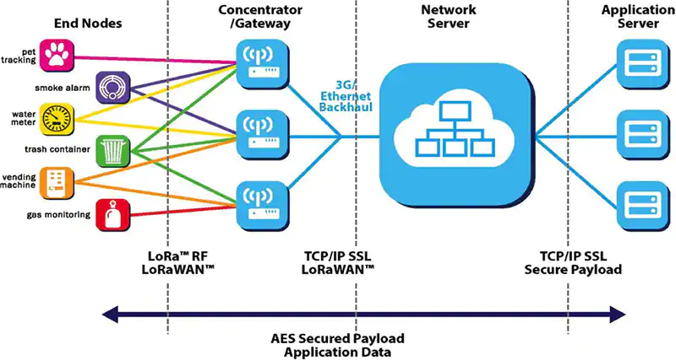
The Kenya and African Context In Leveraging LPWAN Connectivity (LoRa, Sigfox, NB-IoT e.t.c)
Figure 6: LoRa Protocol

Slide 6
What Next
LPWAN network and 4G, 5G broadband mobile communication integration.
IoT solutions user education, marketing, sensitization .
Local IoT community support.
Affordable, robust local IoT hardware and software.
AI integration and deployment.
R&D support with open source datasets, computational resources.
Tapping and supporting talent pool.

Slide 7
The Impact of Tailor-made Tech solutions on Businesses
Automation, remote monitoring and control.
Resources conservation and cost of production reduction.
Data informed decisions, policies, development, operations and strategic plans.
Notable Increased production.
Figure 7: Businesses and institutions have unique challenges and therefore need for tailor-made solutions to reach their highest potential

Slide 8
01
Enhanced engagement
Ongoing collaboration among learning institutions, stakeholders, industry in R&D
HOW LOCALLY MADE SOLUTIONS ARE GOING TO TRANSFORM AFRICA INTO THE FUTURE
02
Taking on real world challenges
There is a push to develop solutions for real problems for instance drought, water, food security, health, environment and education.
03
Capacity building and resources
Private and public mentorship and capacity building for talents and innovation.

Slide 9
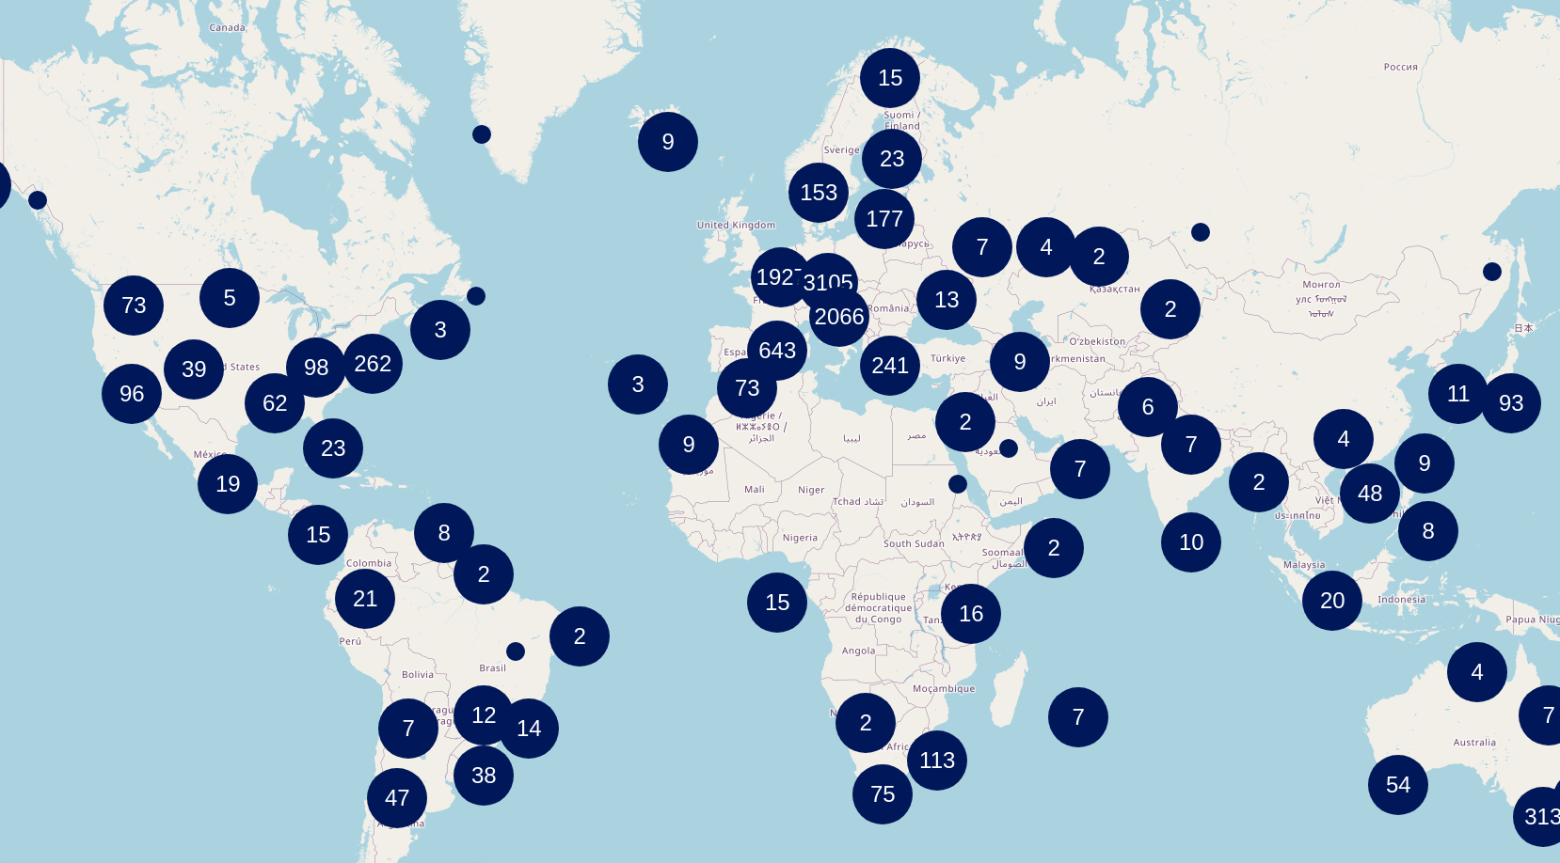
The Utopia
MORE LPWAN INFRASTRUCTURES COMING UP
Figure 8: Current lora network coverage in the world

Slide 10
Thank You
jaredmaks@gmail.com
@JaredMakario

