Slide 1
Power Analysis In IoT
CASE STUDY:
Project Ewaso: Water Resource Monitoring
By:
Jason Kabi

Slide 2
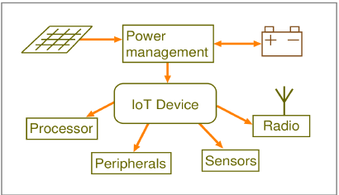
Why power analysis/energy management is important
Power source is small and inefficient (batteries)
Intermittent nature of solar power
Getting an idea of the amount of power being draw by the IoT device.
Importance of the device function. etc.

Slide 3
Electrical Power and Energy
Power: Rate at which electrical energy is transferred by an electrical circuit. Characterized by flow of charge (current) and potential of charge (voltage).
P$ower=VI or I^{2}R or \frac{V^{2}}{R}$
Energy: Power over a time interval.

Slide 4
Power Saving Methods
Processor clock speed throttling
Sleep modes –Project Ewaso
Power off - Project DSAIL camera trap
Peripheral device power down

Slide 5
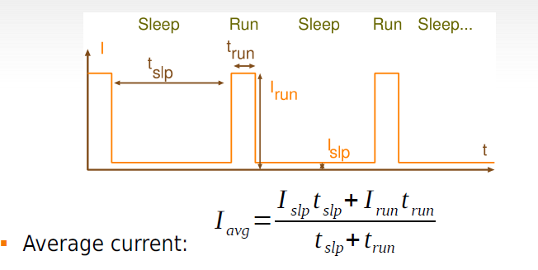
Most Common: Sleep Modes
Stop the processor when not needed.
Sleep mode current | Peak Active mode current | Average current | Sleep mode time t_{sleep} | Active mode time t_{active} | Number of days without solar
2.2mA | 32.6mA | 2.5009mA | 300 seconds | 3 seconds | 110 days

Slide 6
Solar Calculations
Local daily Irradiation GTI = 4500 Wh/m2
Required full charge time tf = 2 days
Solar cell rated voltage Vs = 5V
Solar cell efficiency ηS =15%
Battery capacity CB = 6600mAh
Safety factor: 1.2
Calculate required solar energy: ER
Calculate cell area: AS
$$ER= \frac{CB×Vs×Ss}{\text{η}\text{S}×\text{tf}}= \frac{6600 ×5×1.2}{0.15×2×1000}=132Wh$$
$$AS= \frac{ER}{\text{GTI}}= \frac{132}{4500}=0.02933×10000=293.33{cm }^{2}$$

Slide 7
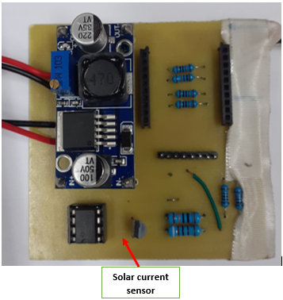
Instrumentation Of Water Level Monitoring Sensor Nodes
Water level sensor
Battery voltage sensor
Solar voltage sensor
Solar current sensor
Water level sensor
Battery voltage sensor

Slide 8
Current sensor layout

Slide 9
Cont.

Slide 10
Deployments

Slide 11
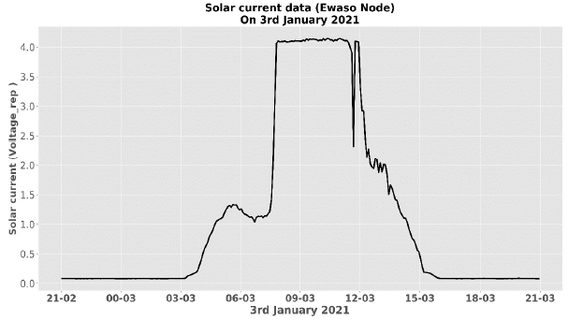
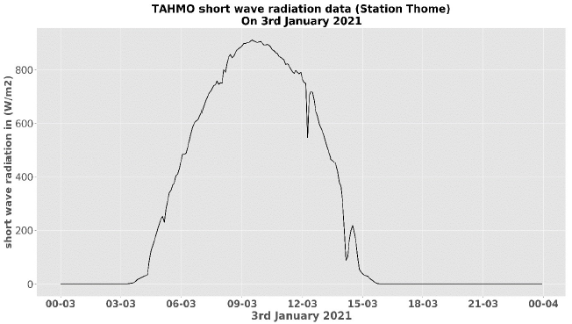
Benefits Of Instrumentation
Evidence of charging
Disconnect detection
Quantify amount of power coming in from the solar source.
Solar current sensor output.

Slide 12
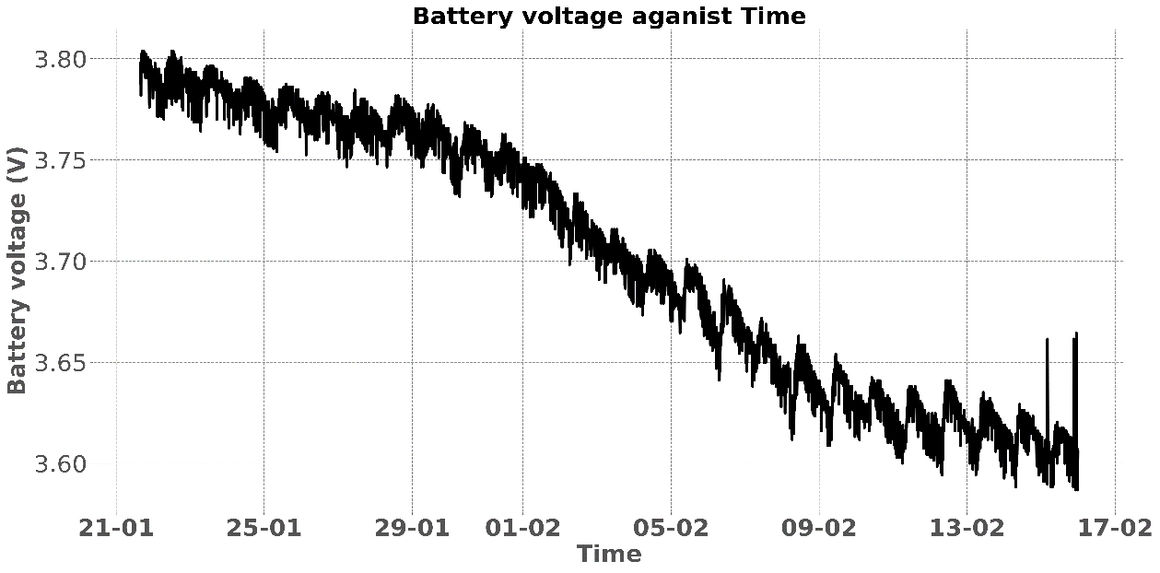
Battery voltage sensor output

Slide 13
End
Thanks

